Slide 1
程式設計實習
2025.3.7

Slide 2
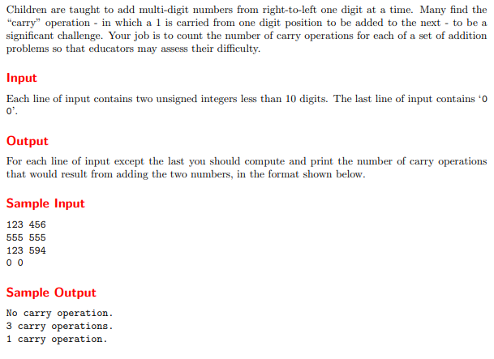
10035 - Primary Arithmetic

Slide 3
#include <iostream>
using namespace std;
int main() {
  int n, m, a, b, carry, count;
  cin >> n >> m;
  while (n != 0 || m != 0) {
    carry = 0;
    count = 0;
    while (n > 0 || m > 0) {
    if (n % 10 + m % 10 + carry >= 10) {
      ++count;
      carry = 1;
  }
    else
      carry = 0;
      n /= 10;
      m /= 10;
  }
    if (count <= 1)
    if (count == 0)
    cout << "No carry operation.\n";
    else
    cout << "1 carry operation.\n";
    else
    cout << count << " carry operations.\n";
    cin >> n >> m;
  }
  return 0;
}
123 456
555 555
123 594
0 0
No carry operation.
3 carry operations.
1 carry operation.
12 89
0 0
2 carry operations.

Slide 4
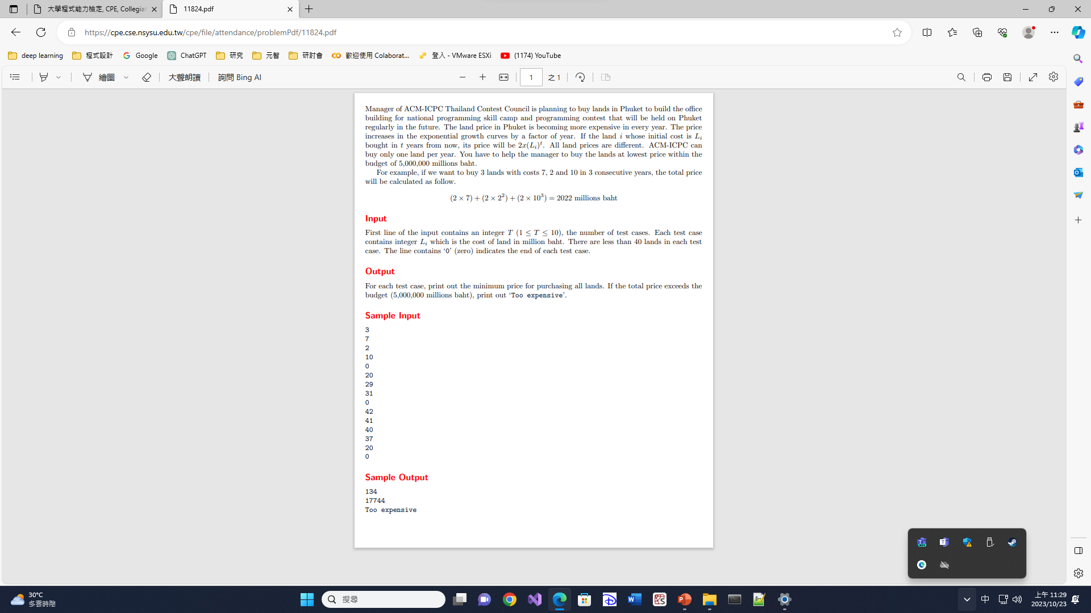
11824 - A Minimum Land Price
2x10+2x7²+2x2³ = 134

Slide 5
#include <iostream>
#include <algorithm>
using namespace std;
int main() {
int t, a[50];
cin >> t;
while (t--) {
int n = 0;
while (cin >> a[n] && a[n])
n++;
sort(a, a + n, std::greater<int>());
int i, j, k;
long long sum = 0, flag = 0, tmp;
for (i = 0; i < n; i++) {
tmp = 1;
for (k = 0; k < i + 1; k++) {
tmp *= a[i];
if (sum + 2 * tmp > 5000000) {
flag = 1;
break;
}
}
if (flag)
break;
sum += 2 * tmp;
}
if (flag)
cout << "Too expensive" << endl;
else
cout << sum << endl;
}
return 0;
}
3
7
2
10
0
20
29
31
0
42
41
40
37
20
0
134
17744
Too expensive

